Slide 1
Multimodal Fusion perception in self-driving

Slide 2
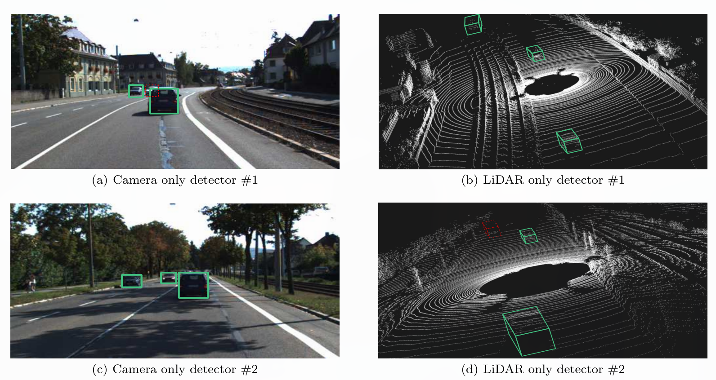
Why Multimodal?
Typical problem using single modal sensors
Notes:
For scene #1, (a) shows a single camera cannot avoid the occlusion problem while the detection result of LiDAR only detector in (b) is correct; For scene #2, camera only detector in (c) performs well while LiDAR only detector shows the difficulty of detecting faraway vehicles with just a few LiDAR points in (d).
In the realistic self-driving situations, performing object detection through a single type of sensor is far from being sufficient. Firstly, each type of sensor has its own inherent shortcomings.
For example, camera only methods suffer from object occlusion; LiDAR methods are hampered by lower input data resolution than images, especially at long ranges.

Slide 3
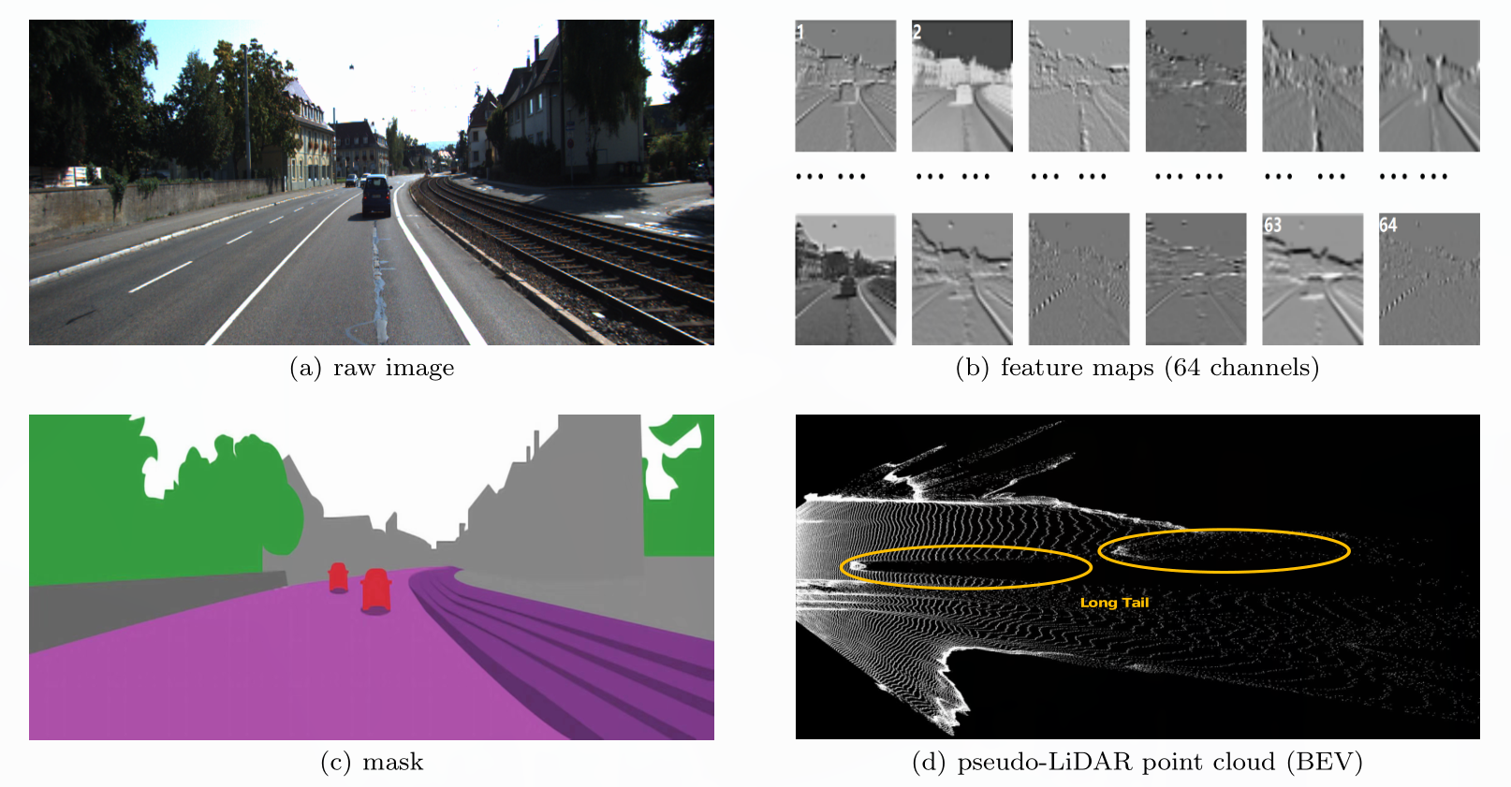
Representation
Image
feature map
mask
pseudo-LiDAR
Notes:
* **feature map**
+ Deep neural networks take 2D images as input and extracts feature maps with a set of convolution operations.
* **mask**
+ To directly get pixel-wise information, e.g. Semantic segmentation result, we can adopt the representation of masks.
* **pseudo-LiDAR**
+ Given stereo or monocular images, we can first predict the depth map, follwed by back-projecting it into a 3D point cloud in the LiDAR coordinate system.
+ A distinction between the pseudo-LiDAR and the LiDAR point cloud is the density of the point cloud.
+ The pseudo-LiDAR representation often has a ***long tail problem***, because the estimated depth is not accurate around the boundaries of the object.
![image-representation](img/image-representation.png)

Slide 4
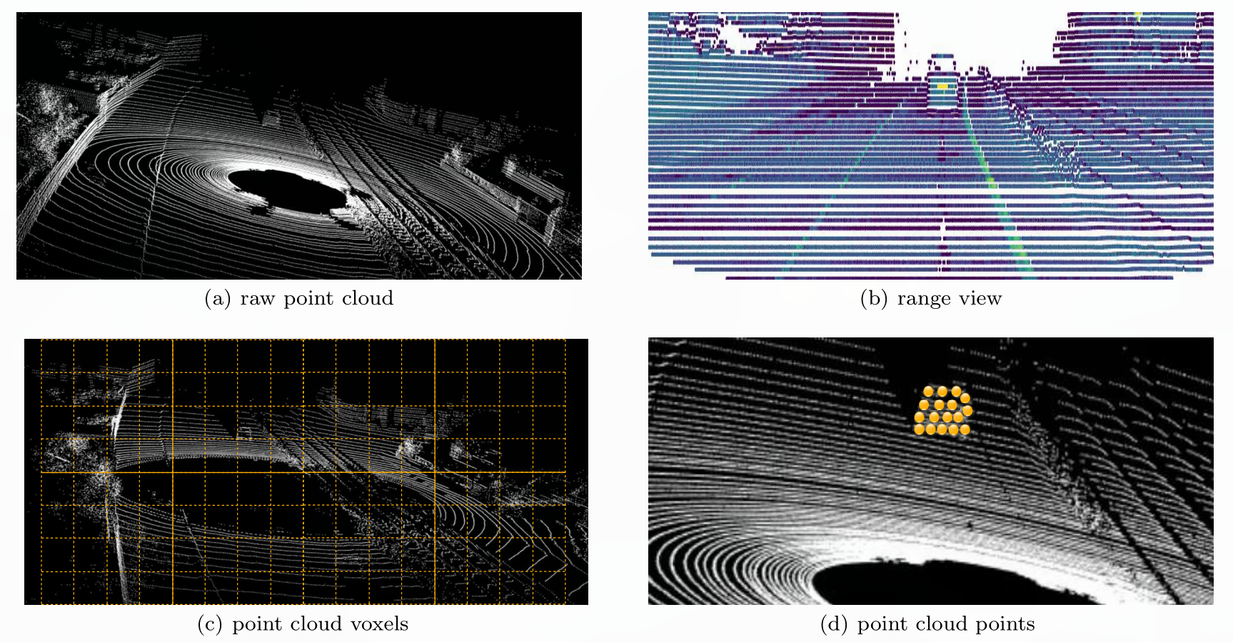
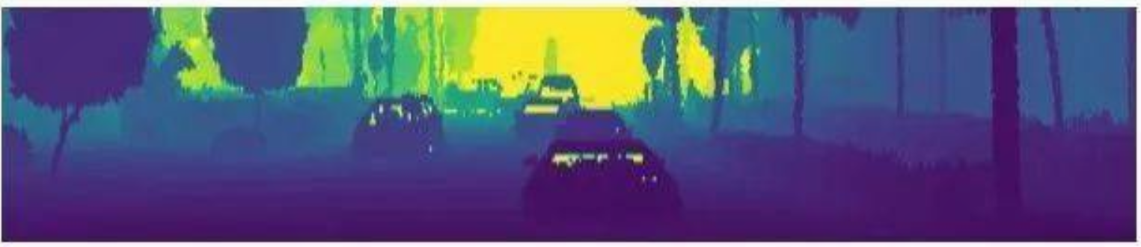
Representation
LiDAR
points
voxels
views
BEV
RV
RV(range view)
Notes:
### LiDAR
A point cloud is basically a set of points in a 3D coordinate system, commonly defined by x, y, z coordinates and the reflection intensity. Since the point cloud data is irregular and sparse, it is important to find a suitable point cloud representation for efficient processing.
* points
+ The raw data of the most LiDARs is quaternion like $(x,y,z,r)$
+ Thanks to 3D point cloud processing networks(PointNet), the raw 3D point cloud can be directly used as input to obtain the suitable point cloud features
* voxels
+ The voxel representation requires discretizing（离散化） the 3D space into 3D voxels and assigning the points to these voxels.
+ It suffers from information loss from quantization.
+ During voxelization, a huge number of empty voxels will be produced as the LiDAR.
+ 3D convolution for voxels is often not efficient and practical in large outdoor scenes for it's expensive computational cost.
* view
Another natural representation is to convert the point cloud data into some kind of 2D view, which can be processed efficiently by 2D CNNs.
+ BEV is commonly adopted in autonomous driving for the reason that there's no overlap between objects in BEV.
+ Another popular view is Range view(RV), which is a native representation of the rotating LIDAR sensor

Slide 5
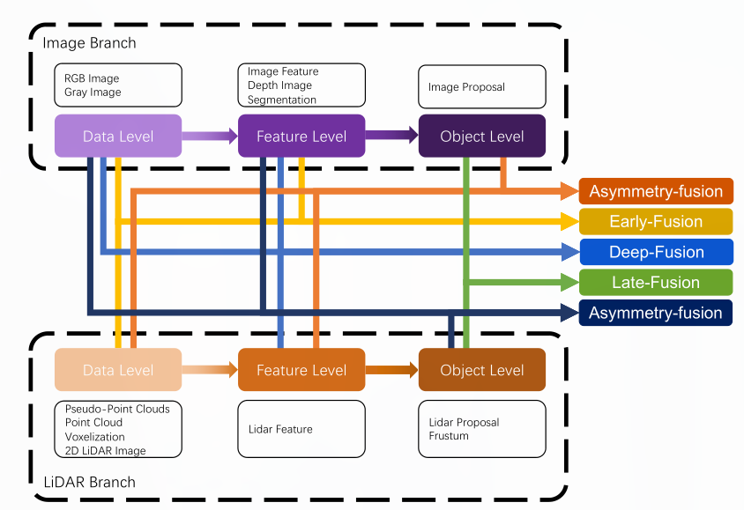
Methods
Taxonomy
The fusion methos can be divided into four categories, as early-fusion, deep-fusion, late-fusion, and asymmetry-fusion.
Notes:
Each minor class is highly dependent on the LiDAR point cloud instead of the camaera data

Slide 6
Early Fusion
Deep Fusion
Late Fusion

Slide 7
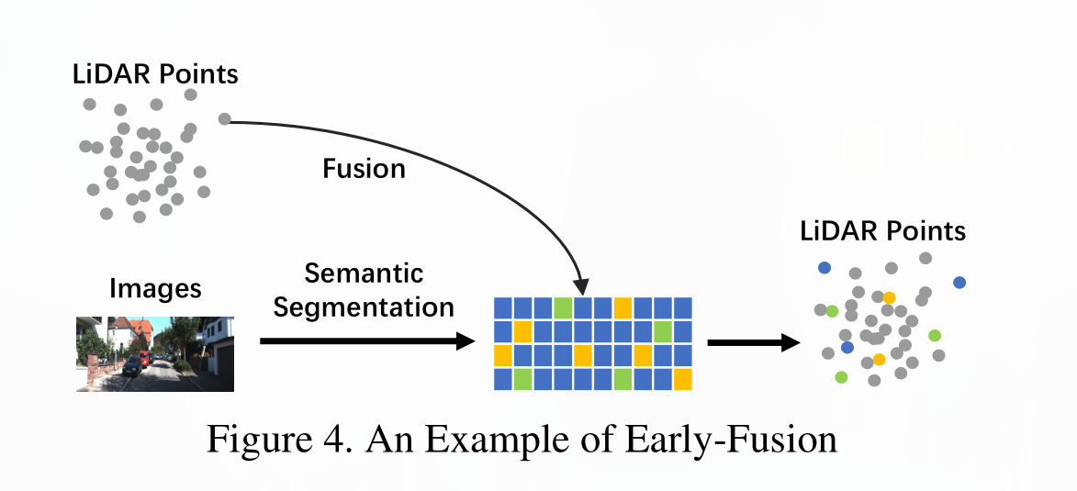
Early Fusion
Early fusion fuses LiDAR data at the data level and camera data at data-level or feature-level. One example of early-fusion can be the model as follows:

Slide 8
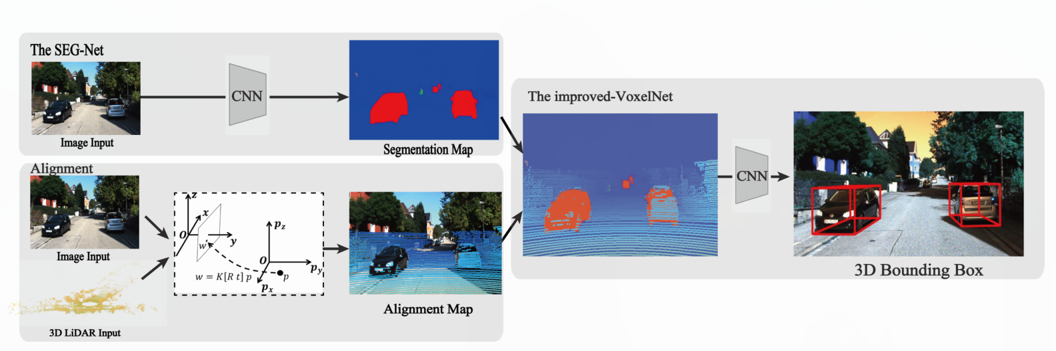
Early Fusion
* Seg-voxelnet(2019): Seg-voxelnet for 3d vehicle detection from rgb and lidar data.
Notes:
The SEG-VoxelNet is composed of two sub-networks: the SEG-Net and the improved VoxelNet. The SEG-VoxelNet extracts semantic feature from image. The Alignment module projects 3D LiDAR point clouds into the image. The improved VoxelNet tasks 3D LiDAR point cloud with corresponding semantic information as input and predicts 3D bounding boxes for vehicles.

Slide 9
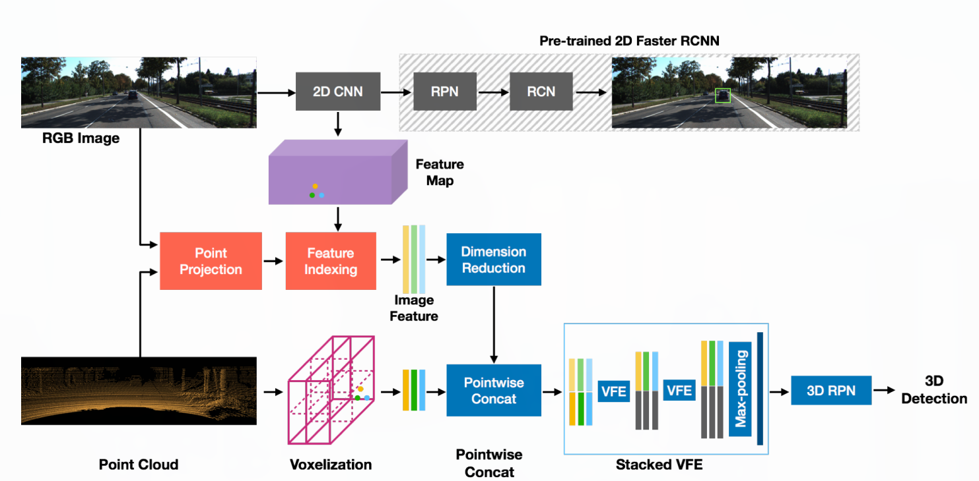
Early Fusion
* Mvx-net(2019): Multimodal voxelnet for 3d object detection.
Notes:
该方法首先使用预先训练的2D检测网络从图像中提取高级特征图。然后使用校准矩阵，将每个3D点投影到图像上，并在该点上附加与投影位置索引对应的特征。从预训练2D检测网络的conv5层提取的特征的维数为512。使用两个具有BN和ReLU的完全连接（FC）层，维度首先降低到96，最后降低到16。然后将它们连接到点特征。连接的特征由体素网中的一组VFE层处理，然后用于检测阶段。

Slide 10
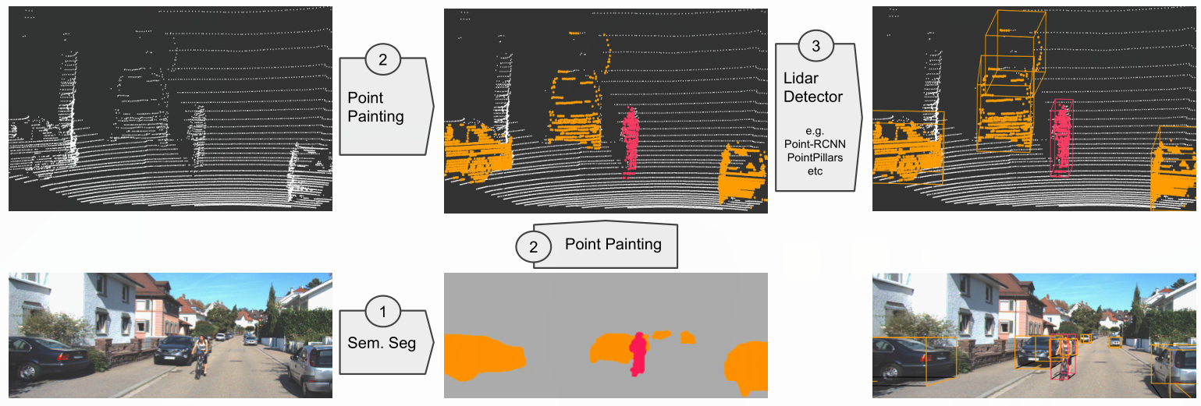
Early Fusion
* Pointpainting(2020): Sequential fusion for 3d object detection.
Notes:
输入rgb图像 → 语义分割 → 点云染色 → 3D检测
第一步：输入rgb图像 → 语义分割，输入图像输出对应的逐像素的语义分类得分。语义分割可以认为是图像特征的压缩表示，其优势在于：语义分割提供了局部的明确的分类得分，可有效补充3D定位和分类信息
第二步，语义分割 → 点云染色 ，利用语义分割结果，对point cloud进行染色，也就是为point could提供类别信息。具体做法是：对于每一个point（x, y, z），找到其在rgb图像上的映射点（u, v），将（u, v）的语义分类结果分配给对应的point（x, y, z）。
第三步，点云染色 → 3D检测，这里其实就只需利用通用的基于点云的3D检测框架即可得到最终结果。需要注意的是，由于叠加了语义信息，这里point cloud的维度发生了变化。

Slide 11
Early Fusion
Deep Fusion
Late Fusion

Slide 12
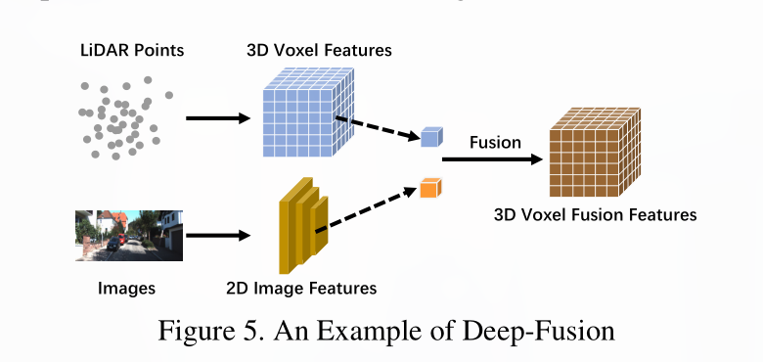
Deep Fusion
Deep-fusion methods fuse cross-modal data at the feature level for the LiDAR branch but data-level and feature-level for the image branch.

Slide 13
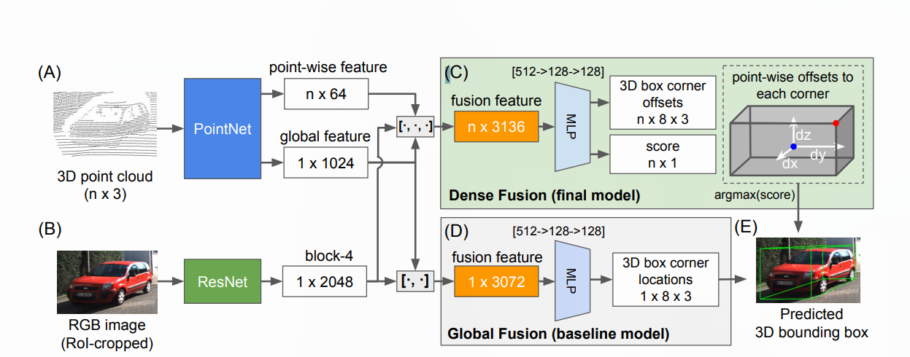
Deep Fusion
* PointFusion(CVPR 2018): Deep sensor fusion for 3d bounding box estimation.
Notes:
PointFusion has two feature extractors: a PointNet variant that processes raw point cloud data (A), and a CNN that extracts visual features from an input image (B). We present two fusion network formulation: a vanilla global architecture that directly regresses the box corner locations (D), and a novel dense architecture that predicts the spatial offset of each of the 0 corners relative to an input point, as illustrated in (C): for each input point, the network predicts the spatial offset (white arrows) from a corner (red dot) to the input point(blue), and selects the prediction with the highest score as the final prediction (E).
输入RGB image crop和与之相对应的raw 3D point cloud，分别通过ResNet和PointNet提取特征，然后对两类特征进行fusion并进一步抽象，最后将3D points视为spatial anchors并进行dense prediction以得到物体的3D bounding box。

Slide 14
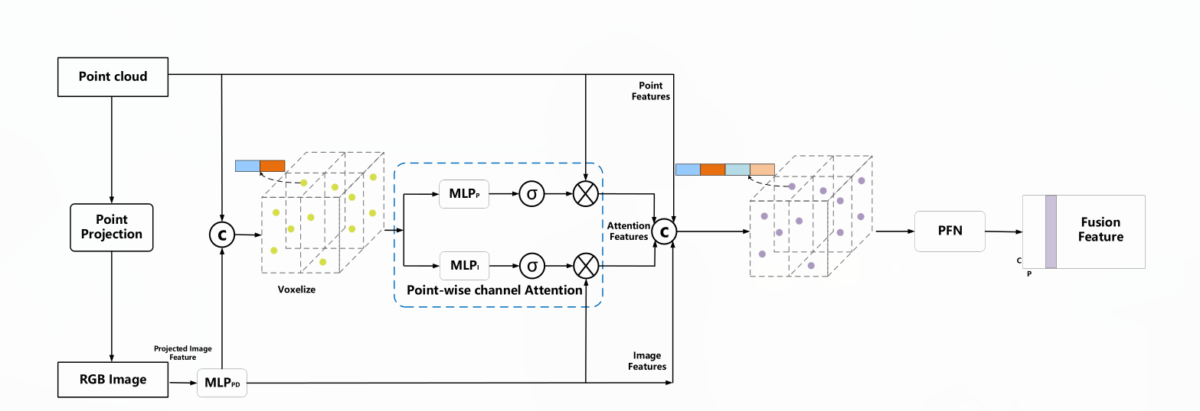
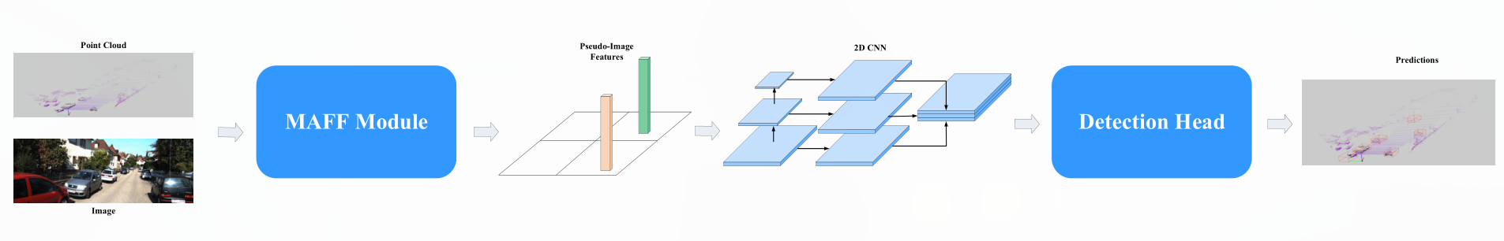
Deep Fusion
* Maff-net(2020): Filter false positive for 3d vehicle detection with multi-modal adaptive feature fusion.
Notes:
It uses point cloud and image as input, outputs a set of pillar-wise fusion feature through MAFF moudle.
concatenate

Slide 15
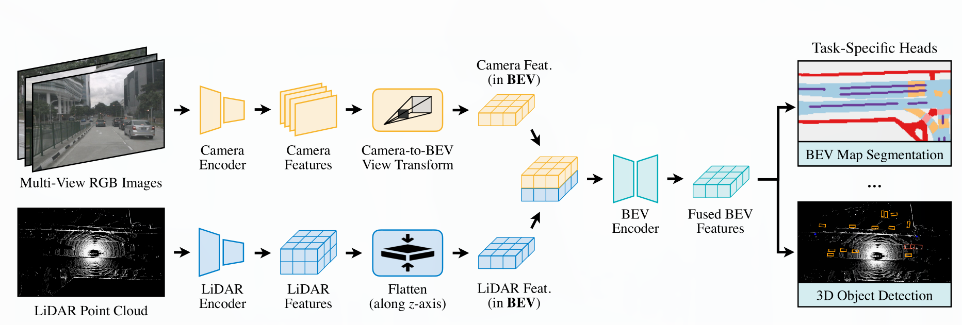
Deep Fusion
* BEVFusion(2022):Multi-Task Multi-Sensor Fusion with Unified Bird’s-Eye View Representation

Slide 16
Deep Fusion
Roifusion(2021): 3d object detection from lidar and vision.
(CVPR 2019): Noise-aware unsupervised deep lidar-stereo fusion.
(CVPR 2017): Fast boosting based detection using scale invariant multimodal multi-resolution filtered features.
Semanticvoxels(2020): Sequential fusion for 3d pedestrian detection using lidar point cloud and semantic segmentation.
(IV 2018): Robust camera lidar sensor fusion via deep gated information fusion network.
(ECCV 2018): Deep continuous fusion for multi-sensor 3d object detection.
R-agno-rpn(2020): A lidar-camera region deep network for resolution-agnostic detection.
(2020): Multi-view adaptive fusion network for 3d object detection.
(2017): Fusing bird view lidar point cloud and front view camera image for deep object detection.

Slide 17
Early Fusion
Deep Fusion
Late Fusion

Slide 18
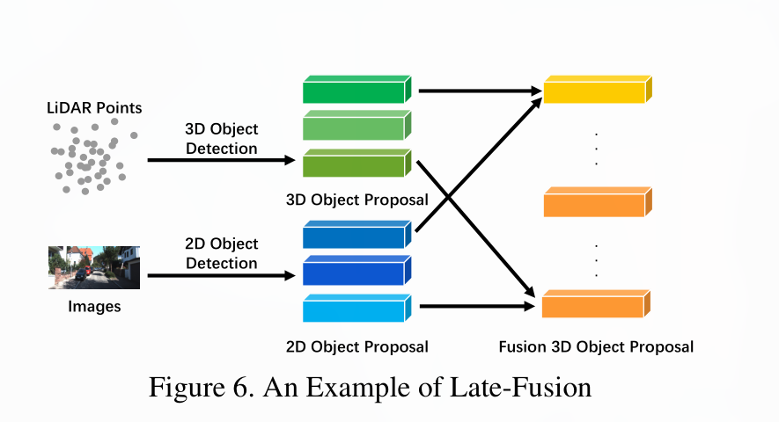
Late Fusion
Late-fusion, also known as object-level fusion, denotes the methods that fuse the result of pipelines in each modality.

Slide 19
Opportunities in Multi-Modal Fusion
More Advanced Fusion Methodology
Misalignment and Information Loss
More Reasonable Fusion Operations
Notes:
The intrinsic and extrinsic of the camera and LiDAR are vastly different from each other. Data in both modalities need to be re-organized under a new coordinate system.
The current research works use intuitive methods to fuse cross-modal data, such as concatenation and element-wise multiply. These simple operation may not be able to fuse the data with a large distribution discrepancy.

Slide 20
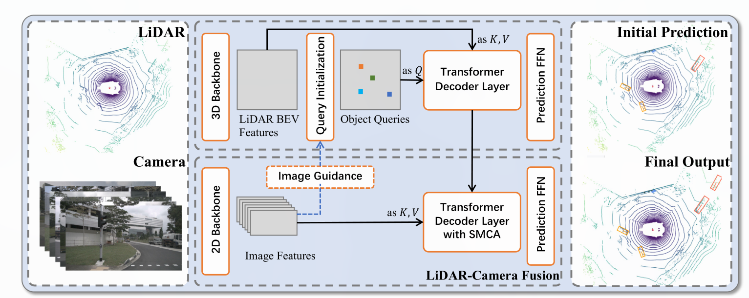
Deep Fusion
* TransFusion(CVPR 2022): Robust LiDAR-Camera Fusion for 3D Object Detection with Transformers
Notes:
TransFusion relies on standard 3D and 2D backbones to extract LiDAR BEV feature map and image feature map. Detection head consists of two transformer decoder layers sequentially:
1. The first layer produces initial 3D bounding boxes using a sparse set of object queries, initialized in a input-dependent and category-aware manner.
2. The second layer attentively associates and fuses the object queries from the first stage with the image features, producing rich texture and color cues for better detection results.
（1）3D点云输入3D backbones获得BEV特征图
（2）初始化Object query按照下图左边的Transformer架构输出初始的边界框预测。
（3）上一步中的3D边界框预测投影到2D图像上，并将FFN之前的特征作为新的query features通过SMCA选择2D特征进行融合。
（4）输出最终的BBOX
（5）为了利用高分辨率的图像，提高对小物体检测的鲁棒性，增加了图像引导的Object query初始化。对步骤（2）进行增强。

Slide 21
Trend
Deep fusion
BEV representation
Notes:
目前的融合工作更多地都是采用deep-fusion的方式，原因主要是这种融合方式的自由度更大，在特征层的融合可以实现不同传感器信息之间的互补

